Slide 1
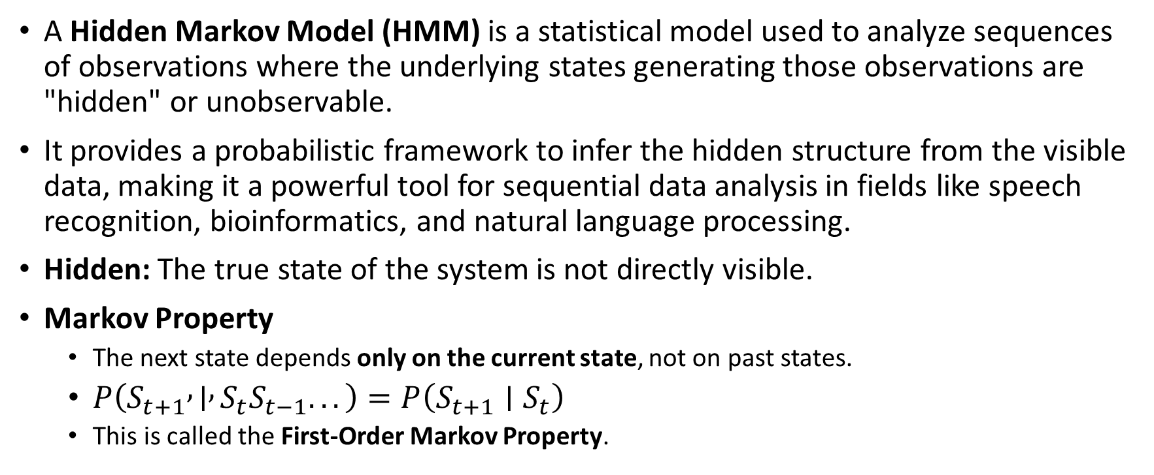
Introduction to HMM (Hidden Markov Model)models
A Hidden Markov Model (HMM) is a statistical model used to analyze sequences of observations where the underlying states generating those observations are "hidden" or unobservable.
It provides a probabilistic framework to infer the hidden structure from the visible data, making it a powerful tool for sequential data analysis in fields like speech recognition, bioinformatics, and natural language processing.
Hidden: The true state of the system is not directly visible.
Markov Property
The next state depends only on the current state, not on past states.
$P\left(S_{t+1} , ∣ , S_{t}S_{t−1}...\right)=P\left(S_{t+1}∣S_{t}\right)$
This is called the First-Order Markov Property.

Slide 2
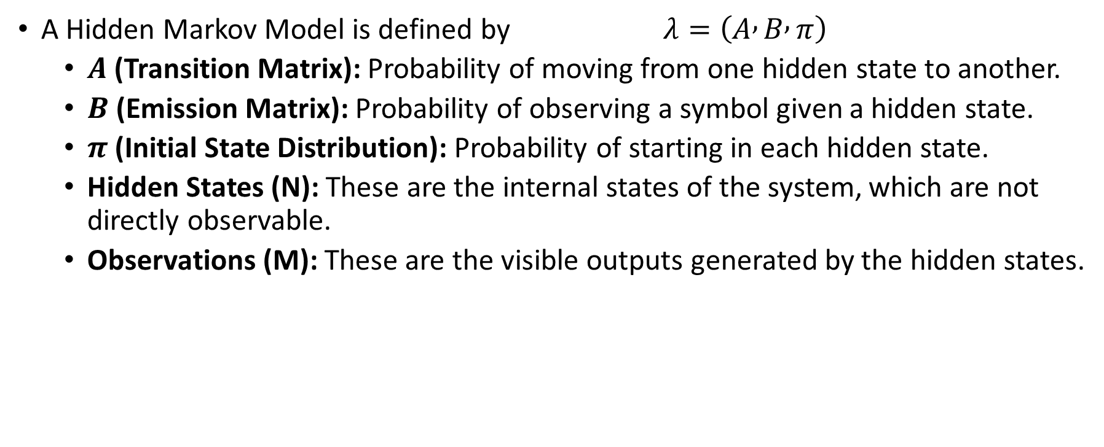
Components of a Hidden Markov Model (HMM)
A Hidden Markov Model is defined by $λ=\left(A , B , π\right)$
$A$ (Transition Matrix): Probability of moving from one hidden state to another.
$B$ (Emission Matrix): Probability of observing a symbol given a hidden state.
$π$ (Initial State Distribution): Probability of starting in each hidden state.
Hidden States (N): These are the internal states of the system, which are not directly observable.
Observations (M): These are the visible outputs generated by the hidden states.

Slide 3
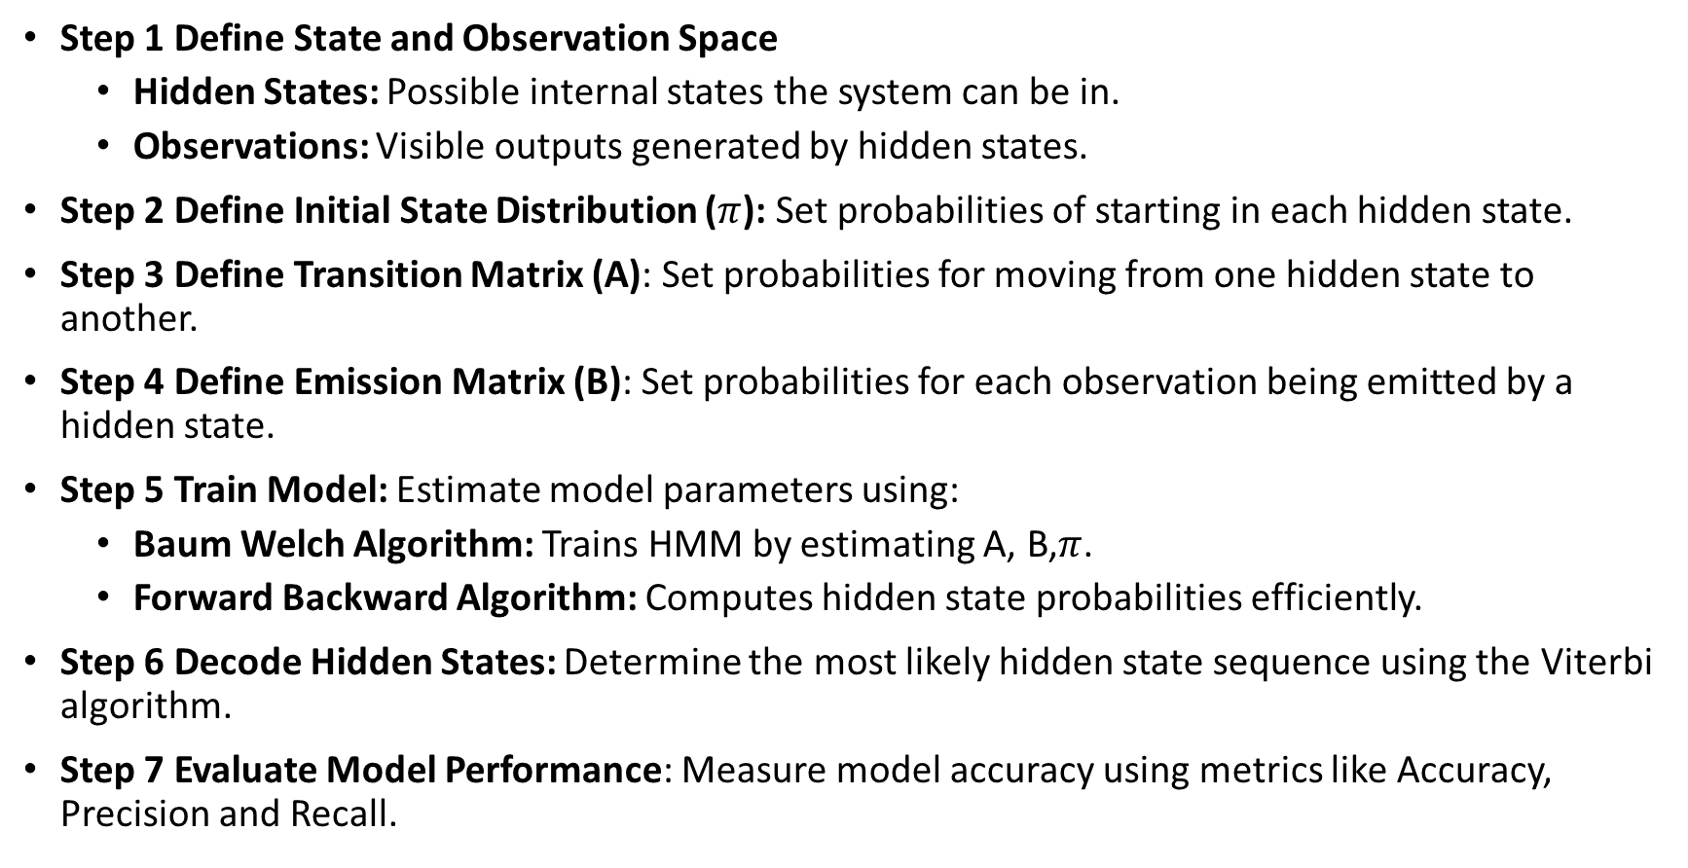
HMM Algorithm
Step 1 Define State and Observation Space
Hidden States: Possible internal states the system can be in.
Observations: Visible outputs generated by hidden states.
Step 2 Define Initial State Distribution ($π$): Set probabilities of starting in each hidden state.
Step 3 Define Transition Matrix (A): Set probabilities for moving from one hidden state to another.
Step 4 Define Emission Matrix (B): Set probabilities for each observation being emitted by a hidden state.
Step 5 Train Model: Estimate model parameters using:
Baum Welch Algorithm: Trains HMM by estimating A, B,$π$.
Forward Backward Algorithm: Computes hidden state probabilities efficiently.
Step 6 Decode Hidden States: Determine the most likely hidden state sequence using the Viterbi algorithm.
Step 7 Evaluate Model Performance: Measure model accuracy using metrics like Accuracy, Precision and Recall.

Slide 4

Three Fundamental Problems in Hidden Markov Models (HMMs)
1. Decoding Problem (Viterbi Algorithm)
Problem: How to find the most likely hidden state sequence that explains the observations?
Mathematically, it finds:
The Viterbi Algorithm efficiently computes this using dynamic programming by keeping track of the maximum probability path to each state at each time step.

Slide 5
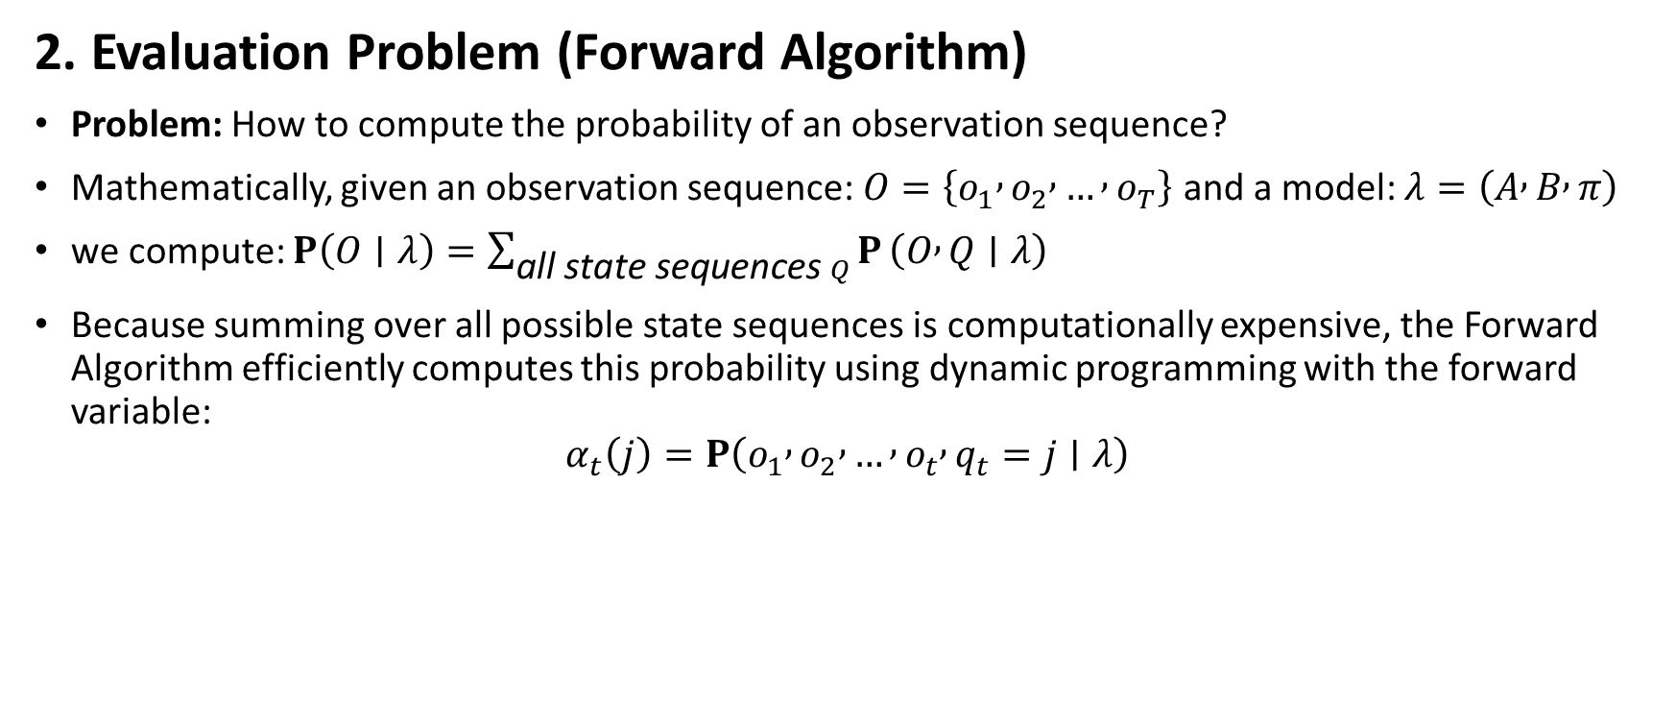
Three Fundamental Problems in Hidden Markov Models (HMMs)
2. Evaluation Problem (Forward Algorithm)
Problem: How to compute the probability of an observation sequence?
Mathematically, given an observation sequence: $O=\left\{o_{1} , o_{2} , … , o_{T}\right\}$ and a model: $λ=\left(A , B , π\right)$
we compute: $P\left(O∣λ\right)=\sum_{\text{all} \text{state} \text{sequences} Q}{P}\left(O , Q∣λ\right)$
Because summing over all possible state sequences is computationally expensive, the Forward Algorithm efficiently computes this probability using dynamic programming with the forward variable:
$$α_{t}\left(j\right)=P\left(o_{1} , o_{2} , … , o_{t} , q_{t}=j∣λ\right)$$

Slide 6

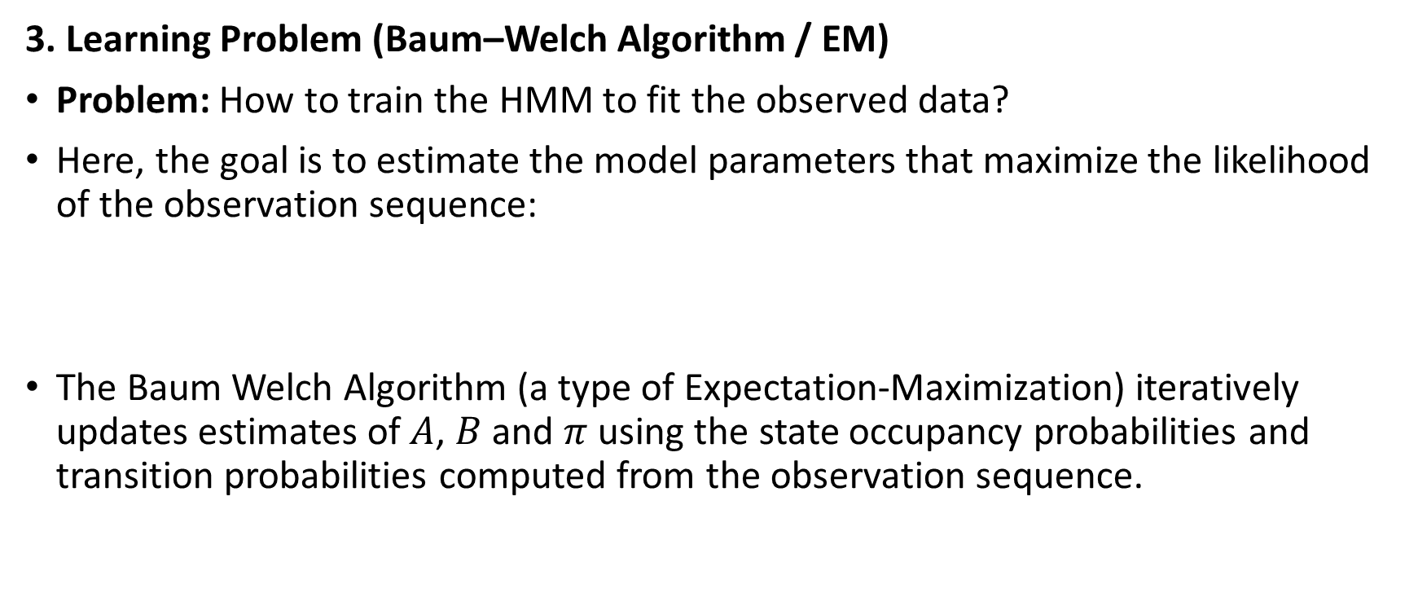
Three Fundamental Problems in Hidden Markov Models (HMMs)
3. Learning Problem (Baum–Welch Algorithm / EM)
Problem: How to train the HMM to fit the observed data?
Here, the goal is to estimate the model parameters that maximize the likelihood of the observation sequence:
The Baum Welch Algorithm (a type of Expectation-Maximization) iteratively updates estimates of $A$, $B$ and $π$ using the state occupancy probabilities and transition probabilities computed from the observation sequence.

Slide 7
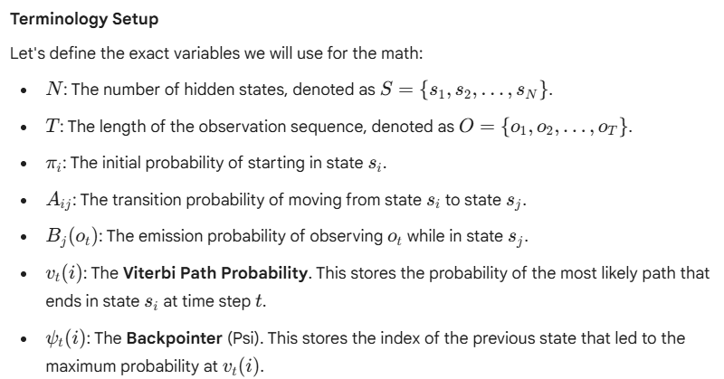
Decoding Problem (Viterbi Algorithm) - Find the most likely hidden state sequence for the given observations

Slide 8
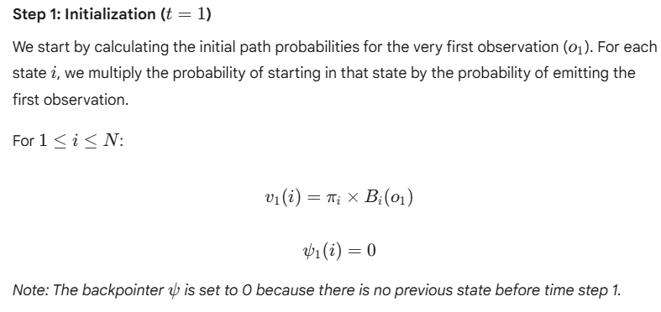
Decoding Problem (Viterbi Algorithm) - Find the most likely hidden state sequence for the given observations

Slide 9
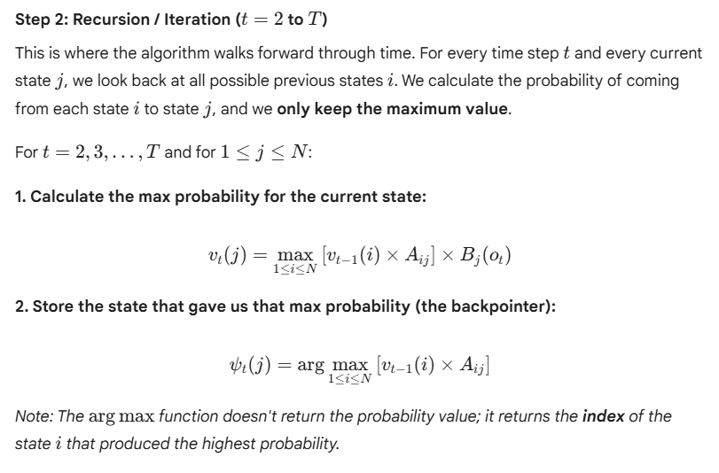
Decoding Problem (Viterbi Algorithm) - Find the most likely hidden state sequence for the given observations

Slide 10
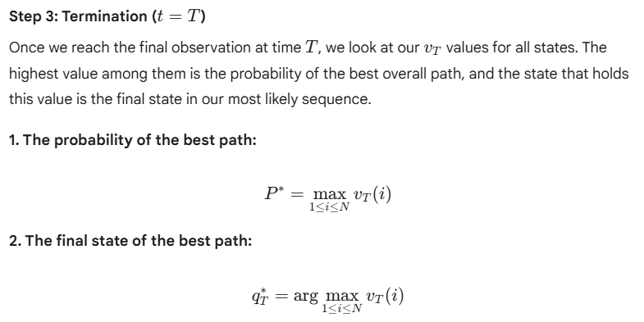
Decoding Problem (Viterbi Algorithm) - Find the most likely hidden state sequence for the given observations

Slide 11
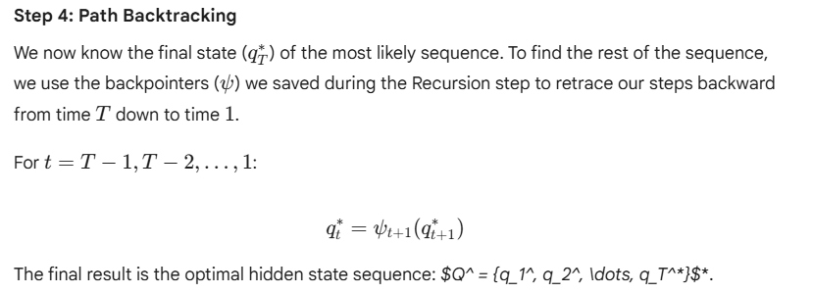
Decoding Problem (Viterbi Algorithm) - Find the most likely hidden state sequence for the given observations

Slide 12
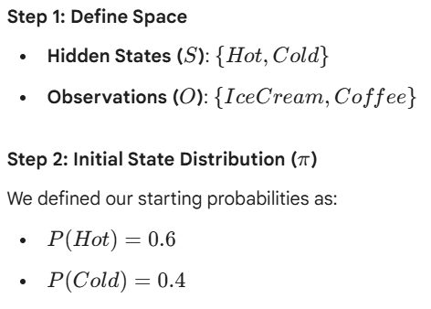
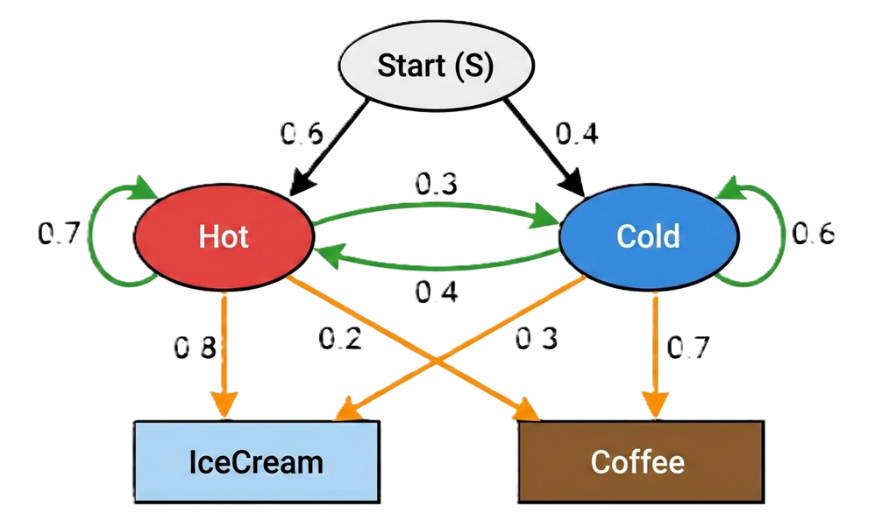
Decoding Problem (Viterbi Algorithm) - Find the most likely hidden state sequence for the given observations

Slide 13
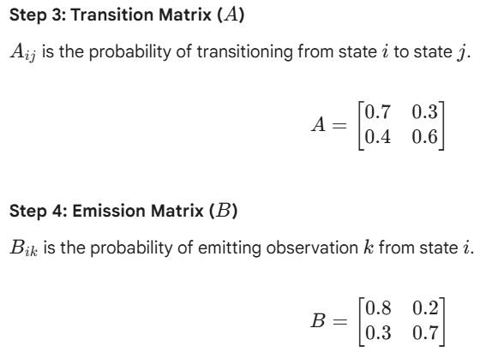
Decoding Problem (Viterbi Algorithm) - Find the most likely hidden state sequence for the given observations

Slide 14
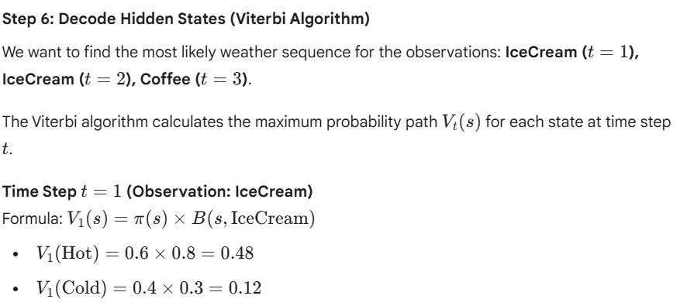
Decoding Problem (Viterbi Algorithm) - Find the most likely hidden state sequence for the given observations

Slide 15
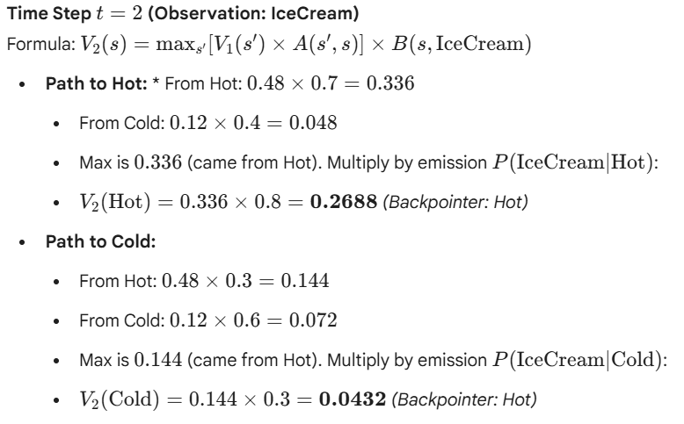
[ V1(Hot) x A(Hot,Hot)]
[V1(Cold) x A(Cold,Hot)]
Max{[ V1(Hot) x A(Hot,Hot)], [V1(Cold) x A(Cold,Hot)]} x B(Hot, Icrcream)
[ V1(Hot) x A(Hot,Cold)]
[V1(Cold) x A(Cold,Cold]

Slide 16
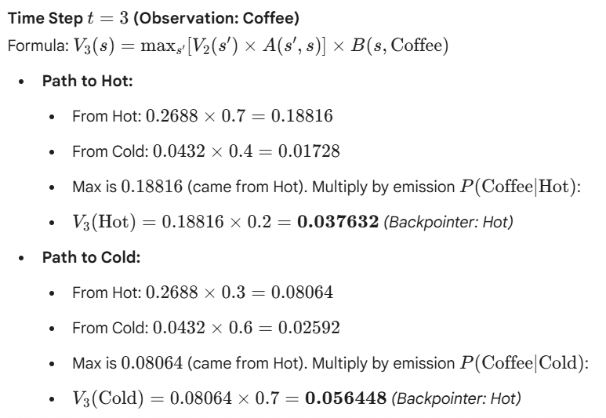

Slide 17
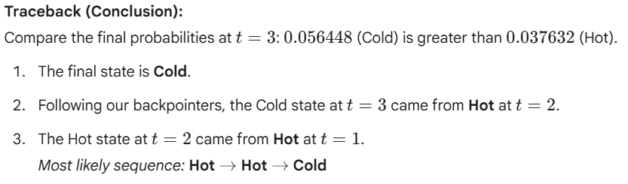
Decoding Problem (Viterbi Algorithm) - Find the most likely hidden state sequence for the given observations

Slide 18
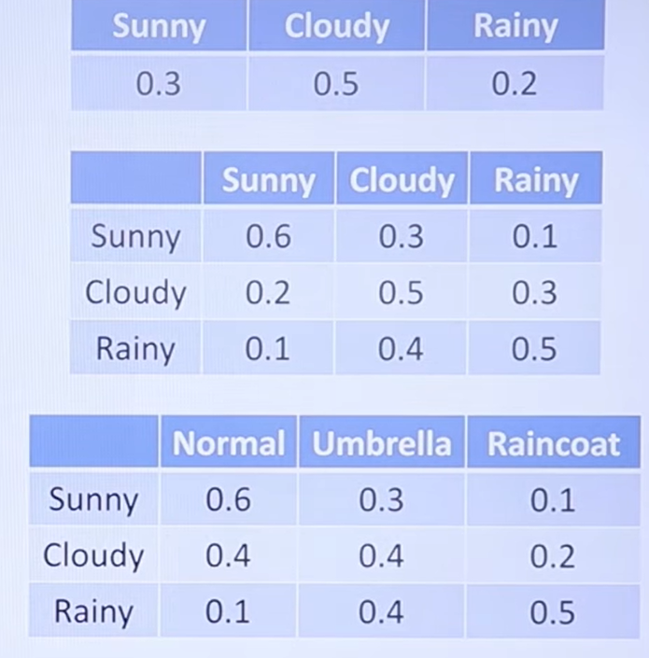
Find the most likely hidden state sequence that explains the observations : a. Normal, Raincoat, Umbrella b. Umbrella, Umbrella, Normal

Slide 19
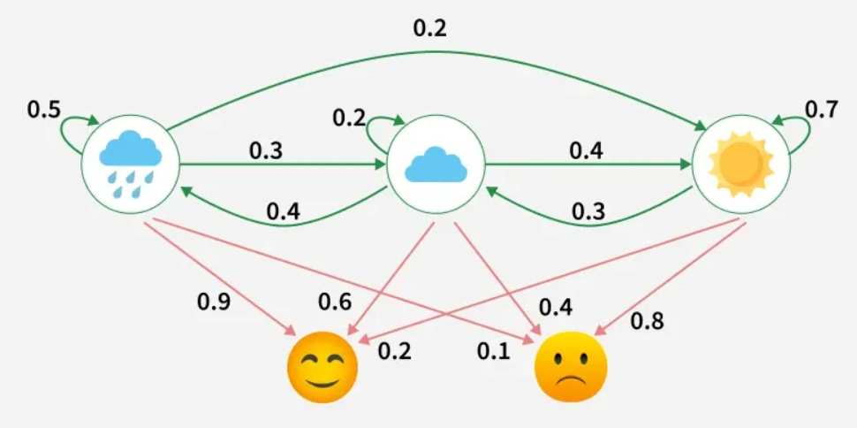
Find the most likely hidden state sequence that explains the observations : S = [Rainy, Cloudy, Sunny] with prob [0.4,0.3,0.3]O =[Happy, Sad] a. Happy, Sad, Sad b. Happy, Happy, Sad

Slide 20
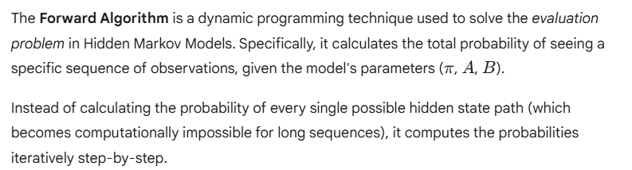
Forward Algorithm for calculation of the probability of an observation sequence

Slide 21
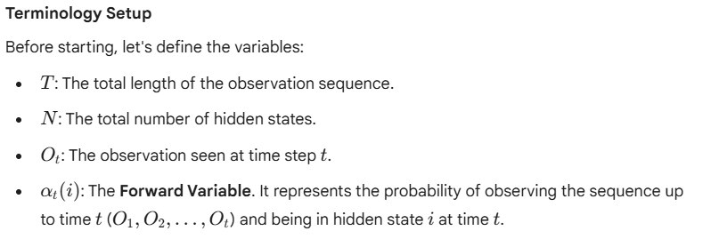
Forward Algorithm for calculation of the probability of an observation sequence

Slide 22
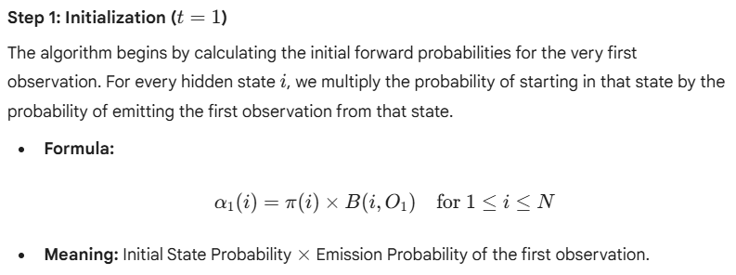
Forward Algorithm for calculation of the probability of an observation sequence

Slide 23
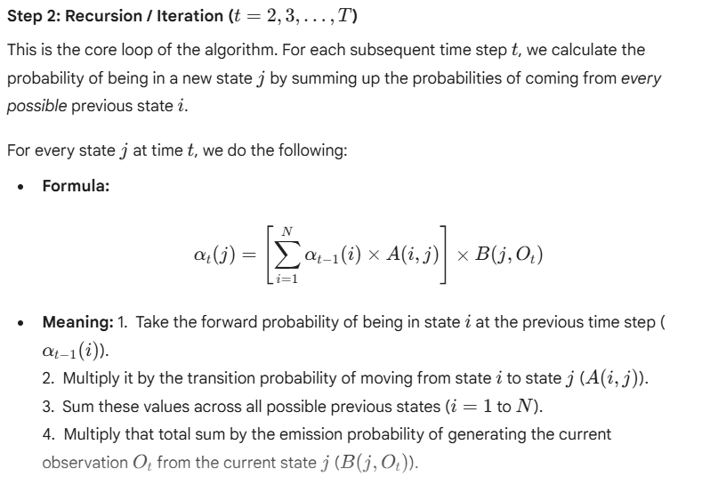

Slide 24
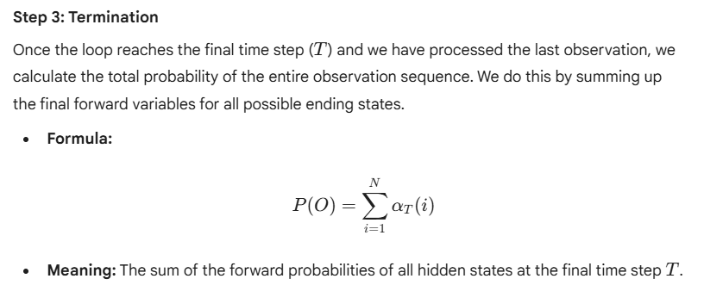
Forward Algorithm for calculation of the probability of an observation sequence

Slide 25
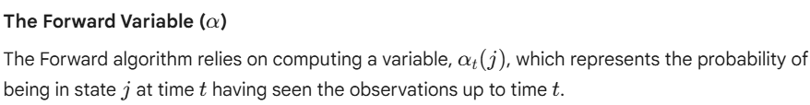
Forward Algorithm for calculation of the probability of an observation sequence

Slide 26
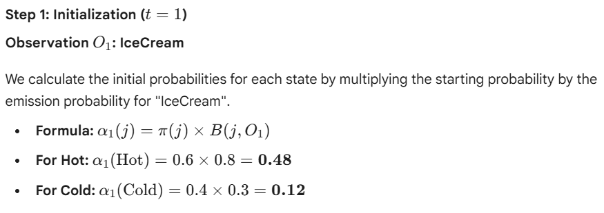
Forward Algorithm for calculation of the probability of an observation sequence

Slide 27
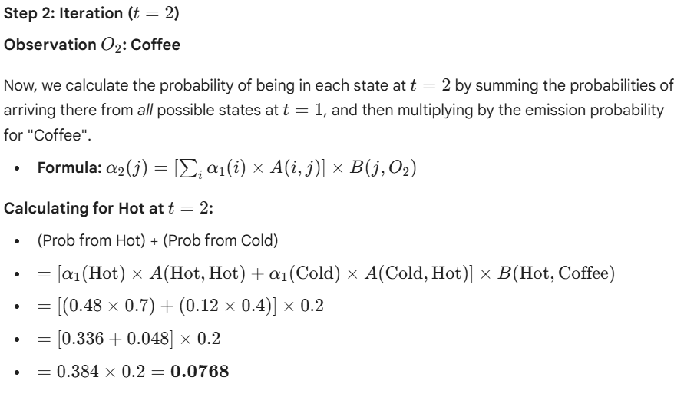
Forward Algorithm for calculation of the probability of an observation sequence

Slide 28
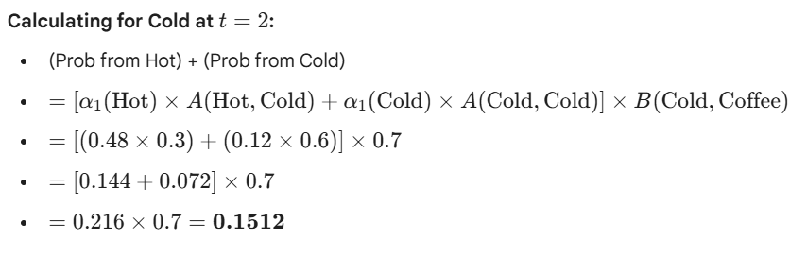
Forward Algorithm for calculation of the probability of an observation sequence

Slide 29
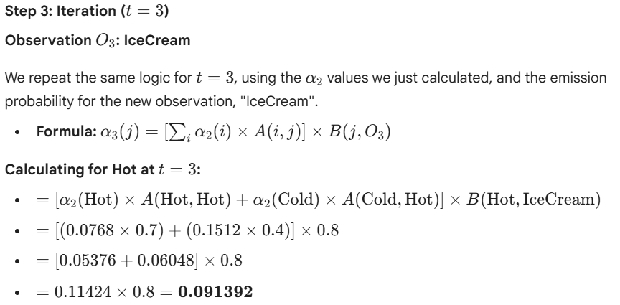
Forward Algorithm for calculation of the probability of an observation sequence

Slide 30
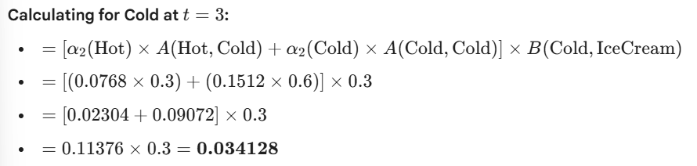
Forward Algorithm for calculation of the probability of an observation sequence

Slide 31
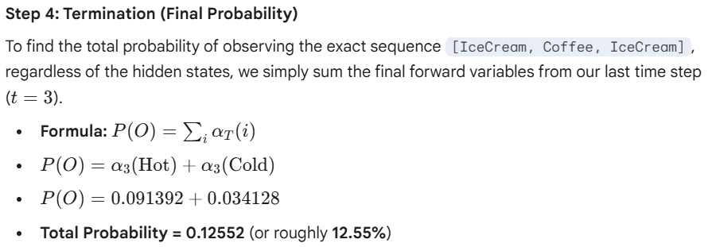
Forward Algorithm for calculation of the probability of an observation sequence

Slide 32
Baum-Welch algorithm
Baum-Welch algorithm is a specific application of the Expectation-Maximization (EM) algorithm designed to find the unknown parameters of a Hidden Markov Model (HMM).
Because we rarely know the true transition or emission probabilities in the real world, this algorithm iteratively guesses, measures the error, and updates its guesses until it finds the parameters that make the observed data most likely.

Slide 33
Baum-Welch algorithm
1. Initialization
Before the algorithm can start learning, it needs a starting point. We define the initial model parameters:
Initial State Probabilities (π): The starting guess for the distribution of hidden states.
Transition Matrix (A): The starting guess for the probabilities of moving between hidden states.
Emission Matrix (B): The starting guess for the probabilities of a hidden state producing a specific observation.
These starting values can be random guesses, uniform distributions, or based on prior domain knowledge.

Slide 34
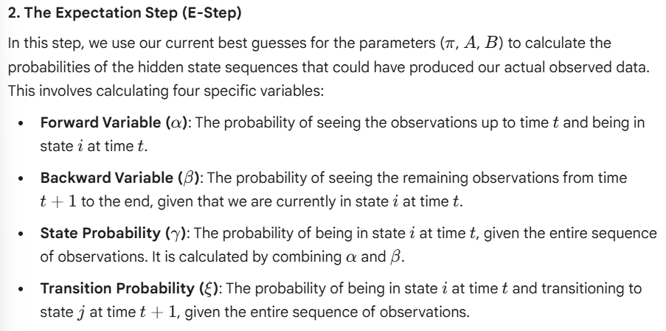
Baum-Welch algorithm

Slide 35
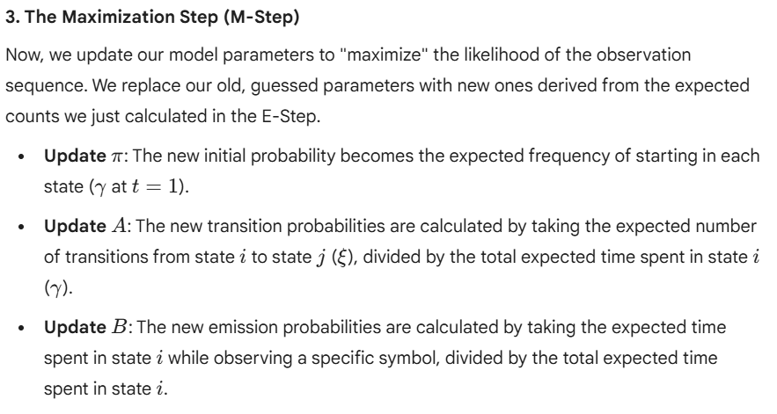
Baum-Welch algorithm

Slide 36
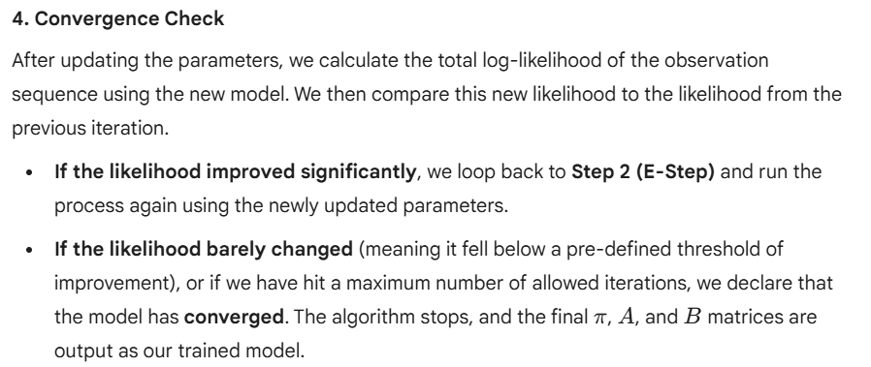
Baum-Welch algorithm

Slide 37
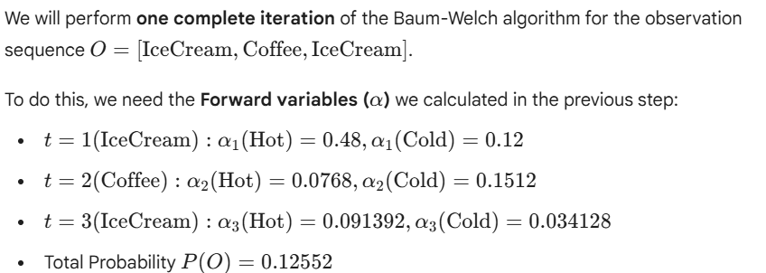
Baum-Welch algorithm

Slide 38
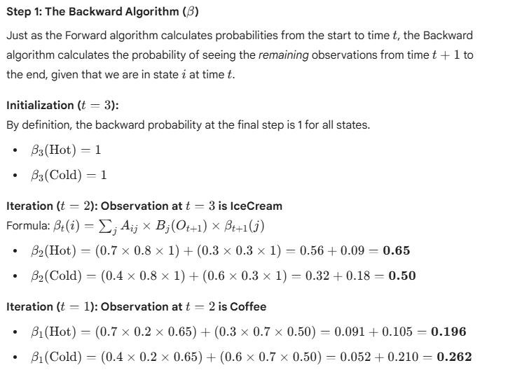

Slide 39
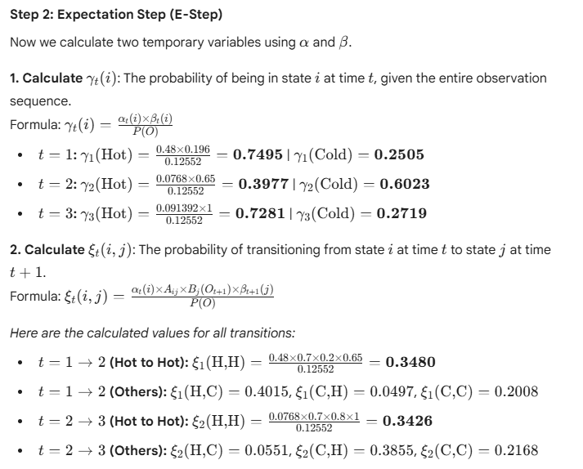

Slide 40
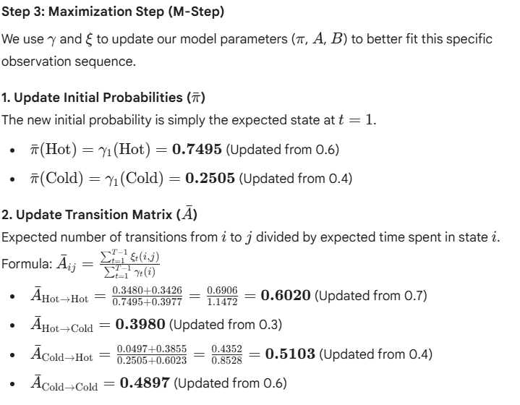

Slide 41
